Slide 1
Gaussian Mixture Models
MCB 288 Spring 2022 lecture 6
February 4 2022

Slide 2
So far, in clustering
K-means (defines K groups)
Hierarchical clustering (e.g., single link)
In both methods we are applying an ad hoc rule; you’re either in one cluster or in another.
“Gaussian mixture models” are an example
https://towardsdatascience.com/gaussian-mixture-models-explained-6986aaf5a95

Slide 3
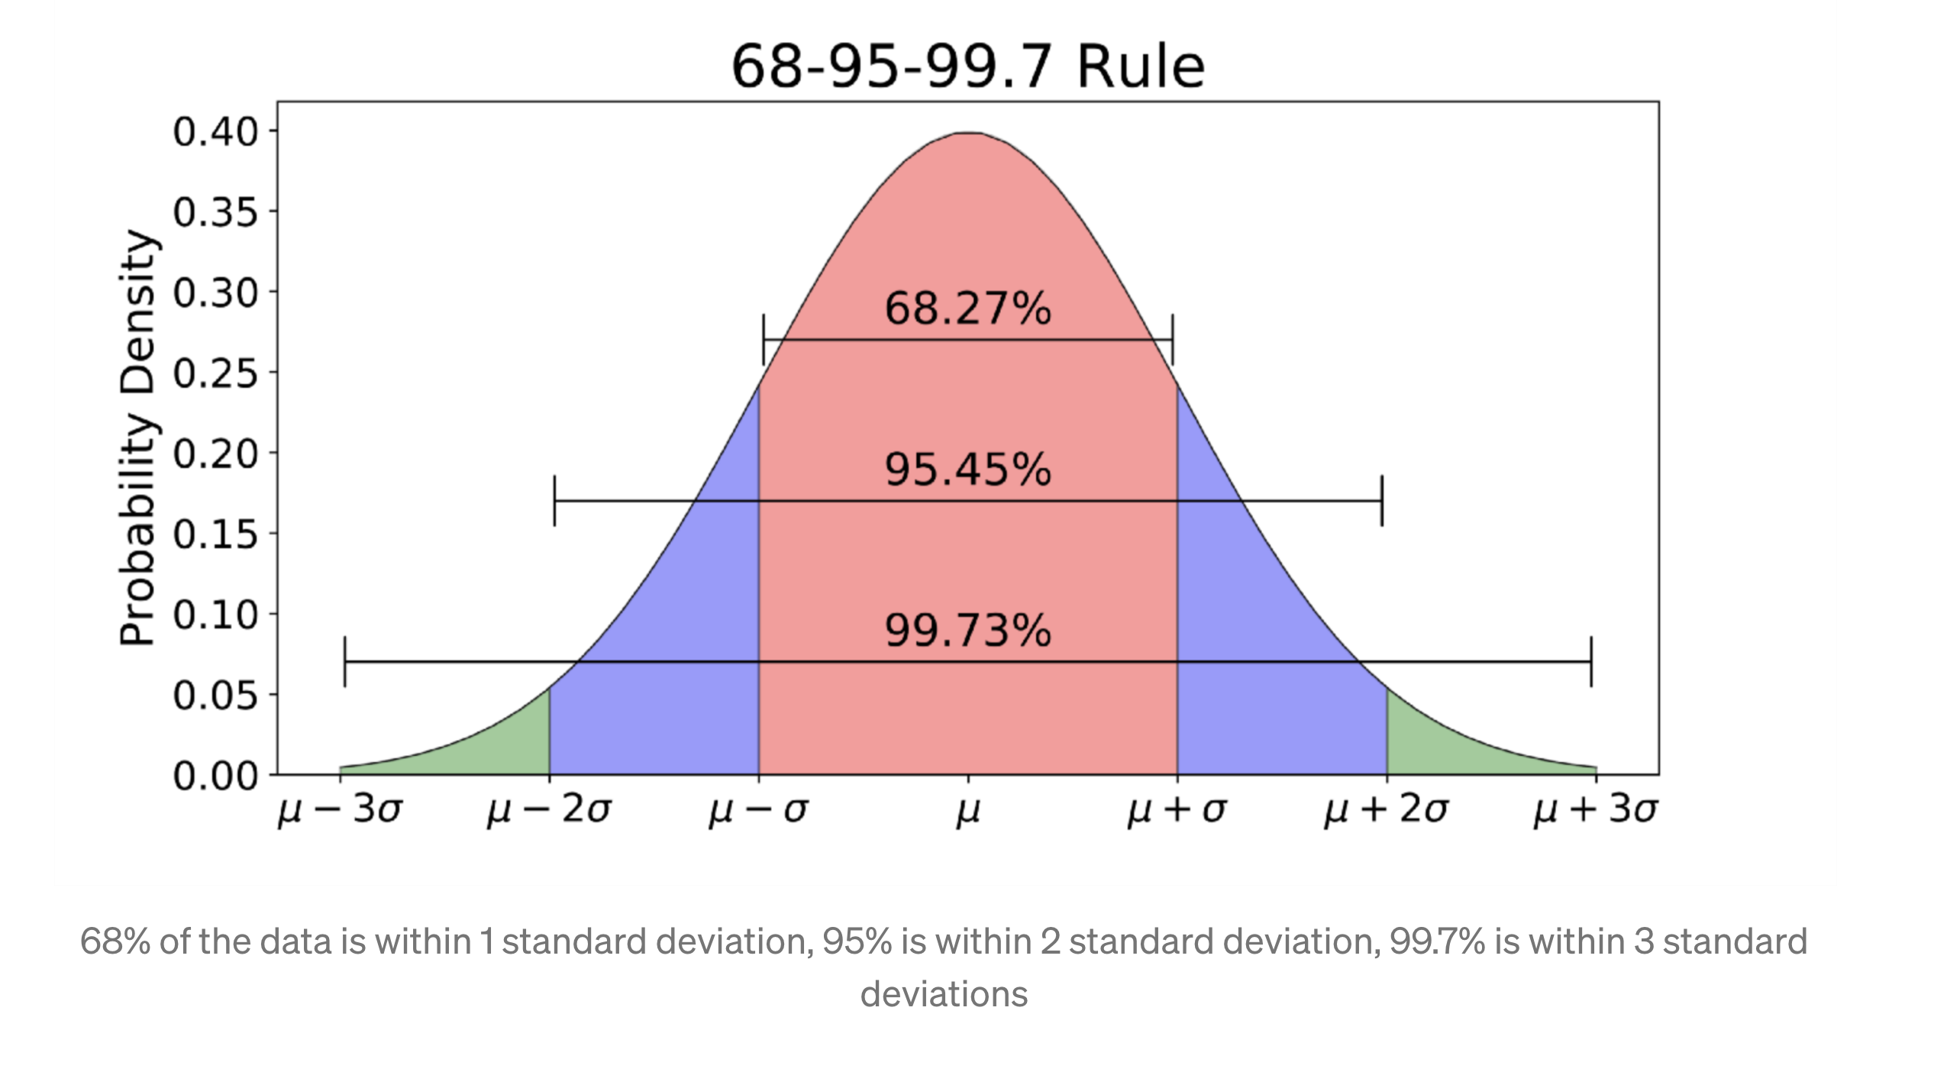
“Gaussian” and “Normal” distributions are synonymous
“Normal” distribution specified by mean, variance. This is the expected distribution of errors assuming that errors are due to a large number of small effects (as we saw in Notebook 1).
Johann Karl Friedrich Gauss (1777-1855): The Prince of Mathematics
“Gauss was an ardent perfectionist and a hard worker. He was never a prolific writer, refusing to publish work which he did not consider complete and above criticism. This was in keeping with his personal motto pauca sed matura ("few, but ripe"). “
“His personal diaries indicate that he had made several important mathematical discoveries years or decades before his contemporaries published them… if Gauss had published all of his discoveries in a timely manner, he would have advanced mathematics by fifty years.”
”[Gauss] did not want any of his sons to enter mathematics or science for "fear of lowering the family name", as he believed none of them would surpass his own achievements.”
“Gauss remained mentally active into his old age, even while suffering from gout and general unhappiness. For example, at the age of 62, he taught himself Russian.”

Slide 4
Gaussian Mixture Models
A Gaussian mixture model is a probabilistic model in which the data points are generated from a mixture (sum) of a finite number of Gaussian distributions with parameters to be determined.
mixture models are generalizations of k-means clustering that incorporate information about the covariance structure of the data within each cluster.
Since there is an underlying probabilistic model, we can use ot to generate additional pseudo-examples of the data

Slide 5
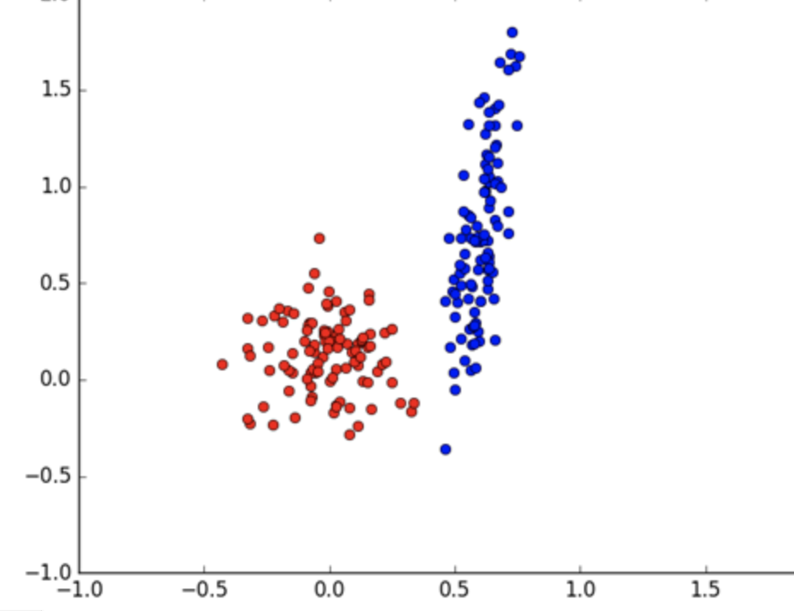
Expectation-maximization
Model is defined by parameters
For GMM:
frequency of each group (i.e., size)
Center of each group (like mean in k-means)
Variance of each group (in high dimensions defines ellipsoidal contours, to take into account any correlations within the cluster.)

Slide 6
Expectation-maximization
Model is defined by parameters
For GMM:
frequency of each group (i.e., size)
Center of each group (like mean in k-means)
Variance of each group (in high dimensions defines ellipsoidal contours, to take into account any correlations within the cluster.)
Algorithm:
Pick arbitrary starting parameters to define model
Evaluate likelihood that data was generated by that model.
Try out changes to model parameters to try to increase likelihood of “fit”
Repeat until no further improvement can be made.

Slide 7
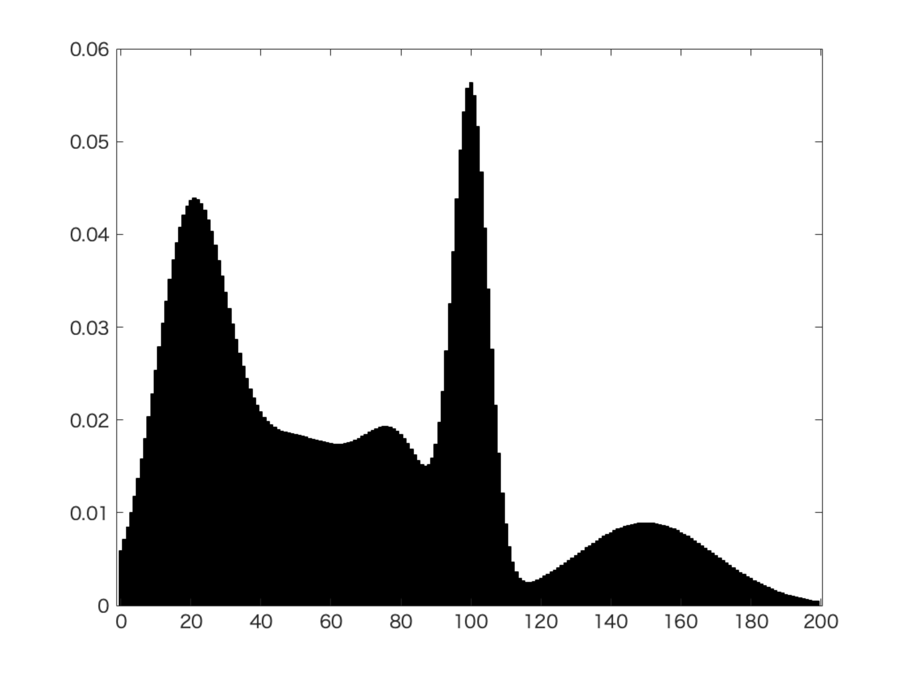
Segmenting an image (“fuzzy image segmentation: example from Wikipedia “Mixture Model” page)
Image intensity
position

Slide 8
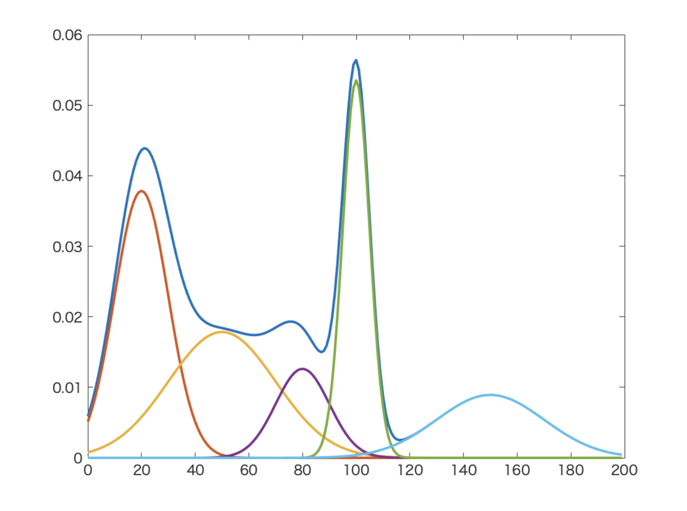
Fit to gaussuan distribution

